Slide 1
Chapter Two Data Communication and Transmission Medias
Data Communication and Computer Networks
(COSC 3081)

Slide 2
2.1Transmission medium
The transmission medium is the physical path between transmitter and receiver in a data transmission system.
Transmission media can be classified as guided or unguided.
In both cases, communication is in the form of electromagnetic waves.
With guided media, the waves are guided along a solid medium, such as copper twisted pair, copper coaxial cable, and optical fiber.
The atmosphere and outer space are examples of unguided media that provide a means of transmitting electromagnetic signals but
do not guide them; this form of transmission is usually referred to as wireless transmission.

Slide 3
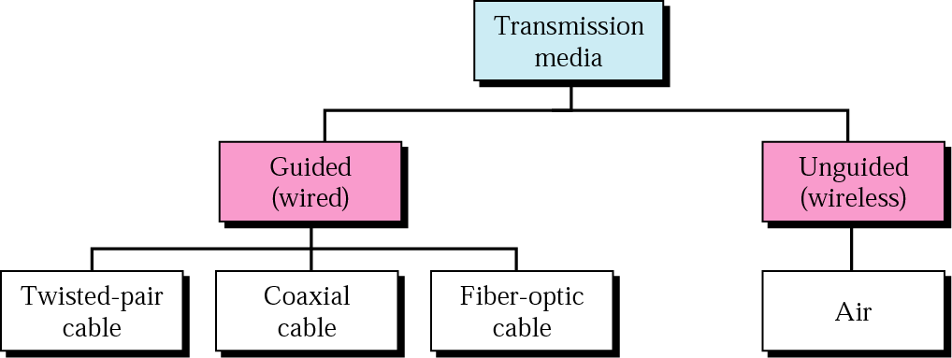
Contd.
In considering the design of data transmission systems, a key concern, generally, is data rate and distance:
the greater the data rate and distance, the better.
A number of design factors relating to the transmission medium and to the signal determine the data rate and distance:

Slide 4
Contd.
Bandwidth:-
All other factors remaining constant, the greater the bandwidth of a signal, the higher the data rate that can be achieved.
2. Transmission impairments:-
Impairments, such as attenuation, limit the distance.
For guided media, twisted pair generally suffer more impairment than coaxial cable, which in turn suffers more than optical fiber.
3. Interference:-
Interference from competing signals in overlapping frequency bands can distort or wipe out a signal.

Slide 5
Contd.
Interference is of particular concern for unguided media, but it is also a problem with guided media.
For guided media, interference can be caused by emanations from nearby cables.
For example, twisted pair are often bundled together, and conduits often carry multiple cables.
Interference can also be experienced from unguided transmissions.
Proper shielding of a guided medium can minimize this problem.

Slide 6
Contd.
4. A Number of receivers:-
A guided medium can be used to construct a point-to-point link or a shared link with multiple attachments.
In the latter case, each attachment introduces some attenuation and distortion on the line, limiting distance and/or data rate.

Slide 7
GUIDED TRANSMSSION MEDIA
For guided transmission media, the transmission capacity,
in terms of either data rate or bandwidth,
depends critically on the distance and on whether the medium is point-to-point or multipoint,
such as in a local area network (LAN).
Guided media, which are those that provide a conduit from one device to another,
include twisted-pair cable, coaxial cable, and fiber- optic cable.

Slide 8
GUIDED TRANSMSSION MEDIA---
A signal traveling along any of these media is directed and contained by the physical limits of the medium.
Twisted-pair and coaxial cable
use metallic (copper) conductors that accept and transport signals in the form of electric current.
Optical fiber is a cable that accepts and transports signals in the form of light.

Slide 9
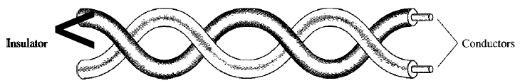
1. Twisted-Pair Cable
A twisted pair consists of two conductors (normally copper), each with its own plastic insulation, twisted together, as shown in the figure below
One of the wires is used to carry signals to the receiver, and the other is used only as a ground reference.
The receiver uses the difference between the two.
In addition to the signal sent by the sender on one of the wires,
interference (noise) and crosstalk may affect
both wires and create unwanted signals.

Slide 10
Contd.
If the two wires are parallel, the effect of these unwanted signals is not the same in both wires
because they are at different locations relative to the noise or crosstalk sources.
This results in a difference at the receiver.
By twisting the pairs, a balance is maintained.
For example, suppose in one twist,
one wire is closer to the noise source and the other is farther; in the next twist, the reverse is true.

Slide 11
Contd.
Twisting makes it probable that both wires are equally affected by external influences (noise or crosstalk).
This means that the receiver, which calculates the difference between the two,
receives no unwanted signals.
The unwanted signals are mostly canceled out.
From the above discussion, it is clear that the number of twists per unit of length (e.g., inch) has some effect on the quality of the cable.

Slide 12
Unshielded Versus Shielded Twisted-Pair Cable
The most common twisted-pair cable used in communications is referred to as unshielded twisted-pair (UTP).
IBM has also produced a version of twisted-pair cable for its use called shielded twisted-pair (STP).
STP cable has a metal foil or braided mesh covering that encases each pair of insulated conductors.
Although metal casing improves the quality of cable by preventing the penetration of noise or crosstalk, it is bulkier and more expensive.
Our discussion focuses primarily on UTP because STP is seldom used outside of IBM.

Slide 13
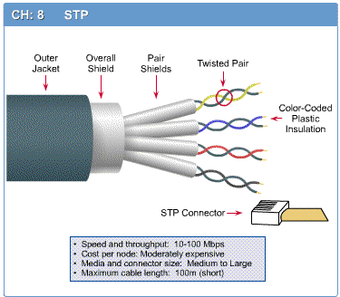
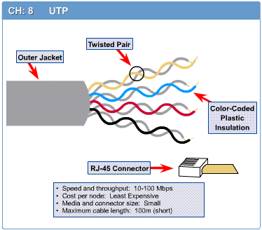
STP
UTP
Notes:
STP

Slide 14
UTP Categories
The Electronic Industries Association (EIA) has developed standards to classify unshielded twisted-pair cable into seven categories.
Categories are determined by cable quality, with 1 as the lowest and 7 as the highest.
Each EIA category is suitable for specific uses.

Slide 15
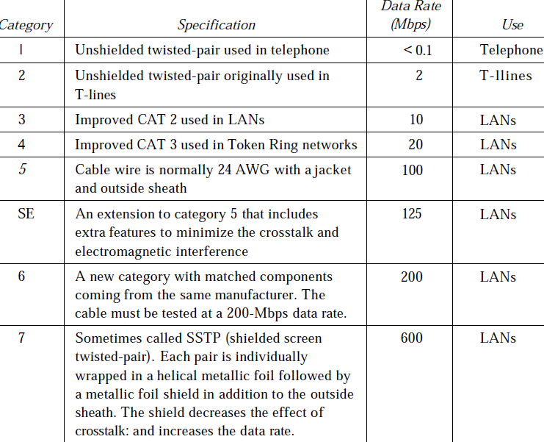


Slide 16
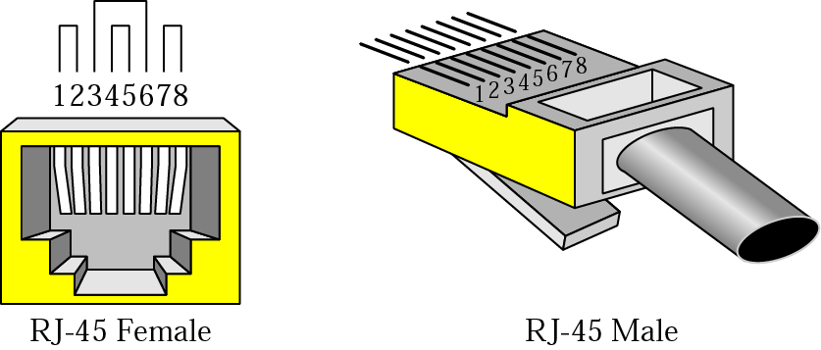
Connectors
The most common UTP connector is RJ45 (RJ stands for registered jack).
The RJ45 is a keyed connector, meaning the connector can be inserted in only one way.

Slide 17
UTP connections
The transmit pin of the source device needs to ultimately connect to the receiving pin of the destination device
There are three types of connections that are used to connect different devices
Straight Through cables
Crossover Cables
Rollover cables

Slide 18
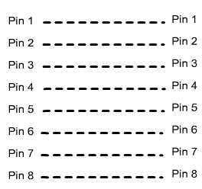
Straight Through cables
Are used to connect dissimilar devices
Switch/Hub to PC
Switch/Hub to Router
Straight Through cable pin out

Slide 19
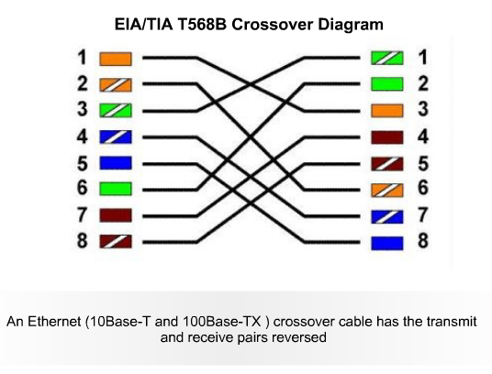
Cross over cable
Connects
Hub to hub
Switch to switch
PC to PC
PC to Router??
Pin out:

Slide 20
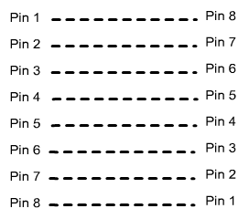
Rollover Cable
Connects
A PC with console port of a router (to configure a router)
Also called Console Cable
Pin-out:

Slide 21
Twisted-pair cable Applications
Within buildings
Most common medium
Twisted-pair cables are used in telephones lines to provide voice and data channels.
The DSL lines that are used by the telephone companies to provide high data rate connections also use the high-bandwidth capability of unshielded twisted-pair cables.
Local area networks, such as 10Base-T and 100Base-T, also used UTP cables.

Slide 22
2. Coaxial Cable
Coaxial cable (or coax) carries signals of higher frequency ranges than those in twisted pair cable,
in part because the two media are constructed quite differently.
Instead of having two wires, coax has a central core conductor of
solid or stranded wire (usually copper) enclosed in an insulating sheath, which is, in turn,
encased in an outer conductor of metal foil, braid, or a combination of the two.

Slide 23
Contd.
The outer metallic wrapping serves both as a shield against noise and as the second conductor, which completes the circuit.
This outer conductor is also enclosed in an insulating sheath, and the whole cable is protected by a plastic cover
outer jacket
(polyethylene)
Outer Conductor
Shield (braided wire)
insulating material
(Insulator)
Inner copper or aluminum
conductor

Slide 24
Contd.
At one time, coaxial cable was the most widely used network cabling.
There were a couple of reasons for coaxial cable's wide usage:
It was relatively inexpensive, and it was light, flexible, and easy to work with.
Shielding protects transmitted data by absorbing stray electronic signals, called noise,
so that they do not get onto the cable and
distort the data.

Slide 25
Types of Coaxial Cable
Thin (thinnet) cable
Thick (thicknet) cable
Thinnet(10Base2):-
It is a flexible coaxial cable about 0.64 centimeters (0.25 inches) thick.
Because this type of coaxial cable is flexible and easy to work with, it can be used in almost any type of network installation.
2. Thicknet(10Base5):- is a relatively rigid coaxial cable about 1.27 centimeters (0.5 inches) in diameter.

Slide 26
Types of Coaxial Cable
Thicknet cable is sometimes referred to as
Standard Ethernet because it was the first type of cable used with the popular network architecture Ethernet.
Thicknet cable's copper core is thicker than a thinnet cable core.
The thicker the copper core, the farther the cable can carry signals.
This means that thicknet can carry signals farther than thinnet cable.

Slide 27
Cont--------
Thicknet cable can carry a signal for 500 meters (about 1640 feet).
Therefore, because of thicknet's ability to support data
transfer over longer distances,
it is sometimes used as a backbone to
connect several smaller thinnet-based networks

Slide 28
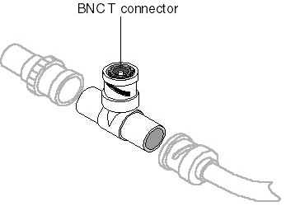
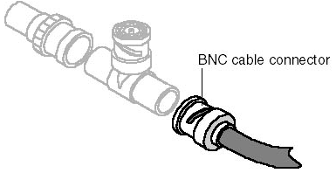
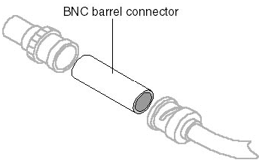
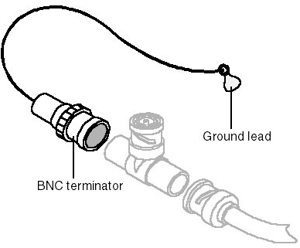
Connector

Slide 29
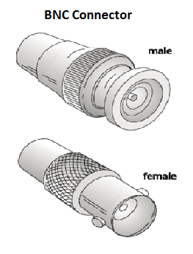
Contd.
The BNC connector is used to connect the end of the cable to a device, such as a TV set.
The BNC T connector is used in Ethernet networks to branch out to a connection to a computer or other device.
The BNC terminator is used at the end of the cable to prevent the reflection of the signal
BNC barrel connector is used to join two lengths of thinnet cable to make one longer length.

Slide 30
Coaxial Cable Applications
Most versatile medium
Television distribution
Ariel to TV
Cable TV
Long distance telephone transmission
Can carry 10,000 voice calls simultaneously
Being replaced by fiber optic
Short distance computer systems links
Local area networks

Slide 31
3. Fiber-Optic Cable
A fiber-optic cable is made of glass or plastic and transmits signals in the form of light.
Fiber-optic cabling consists of a signal-carrying glass core of 5 to 100 microns in diameter
(a sheet of paper is about 25 microns thick and a human hair about 75 microns thick),
surrounded by a layer of pure silica called cladding,
which prevents light from escaping.
Surrounding the cladding are protective layers of acrylic plastic coating, Kevlar fibers for additional strength, and a
PVC (polyvinyl chloride) jacket (usually colored
a distinctive orange).

Slide 32
Contd.
Network components use LED or laser diodes to convert electrical signals into light pulses for transmission on fiber-optic cables.
An optical detector is used to convert the light pulses back into electrical signals.
Optical fibers use reflection to guide light through a channel.
A glass or plastic core is surrounded by a cladding of less dense glass or plastic.

Slide 33

Contd.
The difference in density of the two materials must be such that a
beam of light moving through the core is reflected off the cladding instead of being
refracted into it (cladding)

Slide 34
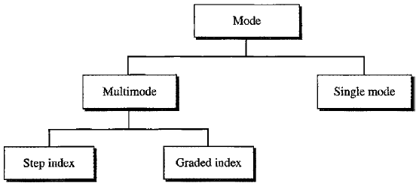
Propagation Modes
Current technology supports two modes (multimode and single mode)
for propagating light along optical channels, each requiring fiber with different physical characteristics.
Multimode can be implemented in two forms: step-index or graded-index

Slide 35
Single-mode fiber-optic cabling
Single mode has a narrow core (5 or 10 microns in diameter) and allows only one signal to be sent or received at a time over very long
distances [about 50 kms] (up to 50 times farther than multimode fiber-optic cabling).
Single-mode fiber-optic cabling uses laser-emitting diodes to introduce signals into the
fiber and can transmit only one signal (light beam) at a time.

Slide 36
Cont------
Signal transmission is clear for approximately 30 miles (50 kilometers) before dispersion will distort signals, which means that single-mode fiber is ideal for long cable runs.
It is suitable for long-distance telephony and multichannel television broadcast systems

Slide 37
Multimode fiber-optic cabling:
Multimode fiber-obtics cable has a thicker core (50, 62.5, or 100 microns in diameter) and
has sufficient bandwidth to allow multiple signals to be simultaneously transmitted or received;
Each signal follows a different path or mode through the fiber.
Signal transmission is clear for approximately 3000 feet (almost 1km),
but longer cable runs can distort signals through modal dispersion.

Slide 38
Cont------
There are two types of multimode fiber:
Step-index multimode fiber
Graded-index multimode fiber
It is suited for use in LAN systems and video surveillance.
Step-index multimode fiber
Less costly variety of multimode fiber, uses a wide core with a constant density from the center to the edges,
causing the light beams to reflect in mirror fashion off the inside surface of the core by the
process of total internal reflection

Slide 39
Cont----
At the interface there is an abrupt change to a lower density that alters the angle of the beam’s motion.
Because light can take many different paths down the
cable and each path takes a different amount of time, signal distortion can result when
step-index fiber is used for long cable runs.
Used only for short cable runs.

Slide 40
2. Graded-index multimode fiber
The more expensive type of multimode fiber.
A graded-index fiber is one with varying densities.
Density is highest at the center of the core and decreases gradually to its lowest at the edge.
Therefore, light beams follow curved paths and all rays reach the end of the fiber simultaneously
This reduces the signal distortion that occurs in step-index fiber when long cable runs are used.

Slide 41
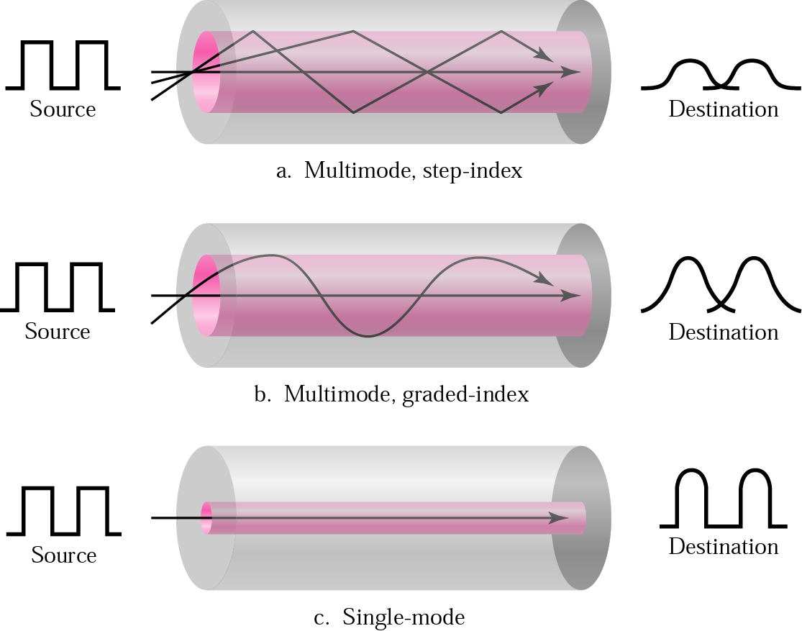
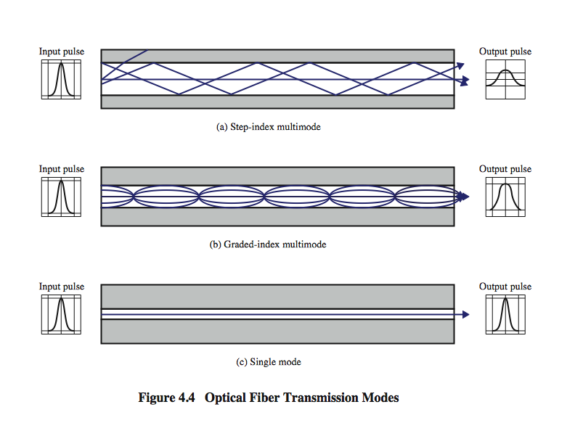


Slide 42
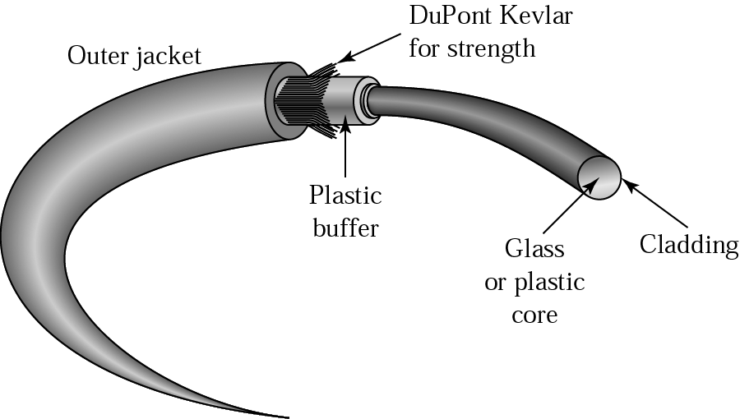
Cable Composition
The outer jacket is made of either PVC (polymer of vinyl chloride) or Teflon.
Inside the jacket are Kevlar strands to strengthen the cable.
Kevlar is a strong material used in the fabrication of bulletproof vests.
Below the Kevlar is another plastic coating to cushion the fiber.
The fiber is at the center of the cable, and it consists of cladding and core.

Slide 43
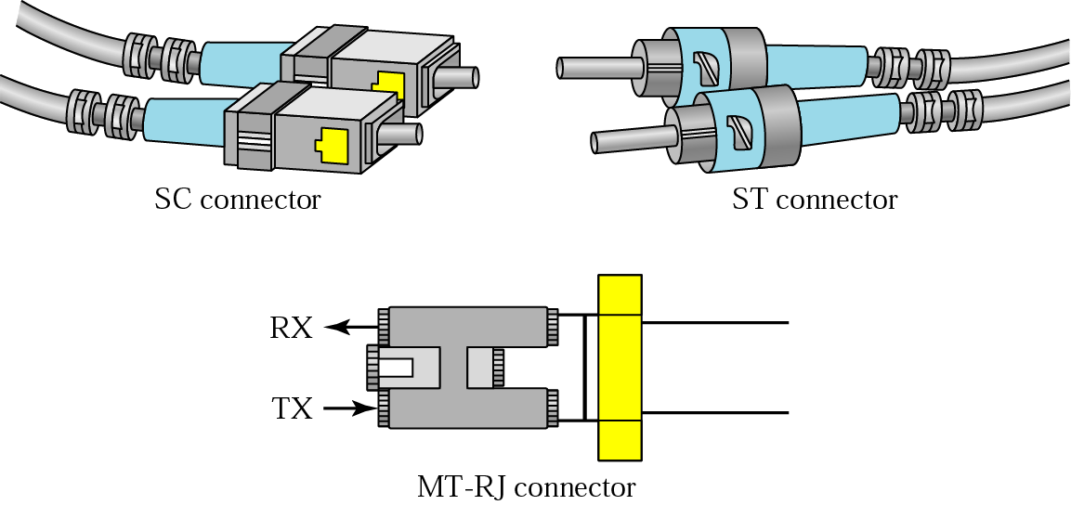
Fiber-Optic Cable Connectors
There are three types of connectors for fiber-optic cables.
Subscriber channel (SC) connector:- is used for cable TV.
It uses a push/pull locking system.
Straight-tip (ST) connector:-
is used for connecting cable to networking devices.
It uses a bayonet locking system and is more reliable than SC.
3. MT-RJ is a connector:- that is the same size as RJ45.

Slide 44
Optical Fiber - Applications
Long-haul trunks
Metropolitan trunks
Rural exchange trunks
Subscriber loops
LANs

Slide 45
Advantages of Optical Fiber
The major advantages offered by fiber-optic cable over twisted-pair and coaxial cable are noise resistance, less signal attenuation, and higher bandwidth.
Noise Resistance:
Because fiber-optic transmission uses light rather than electricity, noise is not a factor.
External light, the only possible interference, is blocked from the channel by the outer jacket.
2. Less signal attenuation:-
Fiber-optic transmission distance is significantly greater than that of other guided media.

Slide 46
Cont----
A signal can run for miles without requiring regeneration.
Higher bandwidth:-
Currently, data rates and bandwidth utilization over fiber-optic cable are limited not by the medium but by the signal generation and reception technology available.

Slide 47
Disadvantages of Optical Fiber
The main disadvantages of fiber optics are cost, installation/maintenance, and fragility.
Cost:-
Fiber-optic cable is expensive.
Also, a laser light source can cost thousands of dollars, compared to hundreds of dollars for electrical signal generators.
2. Installation/maintenance
3. Fragility:-
Glass fiber is more easily broken than wire, making it less useful for applications where hardware portability is required.

Slide 48
4. Unguided (Wireless) Media
Unguided media transport electromagnetic waves without using any physical conductor.
This type of communication is often referred to as wireless communication.
Signals are normally broadcast through
free space and thus are available to
anyone who has a device capable of receiving them.

Slide 49
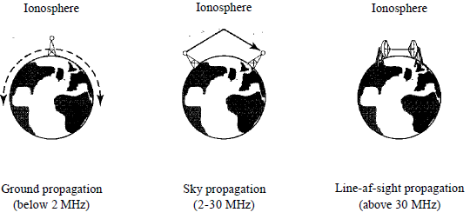
Cont------
Unguided signals can travel from the source to destination in several ways:
ground propagation,
sky propagation, and
line-of-sight propagation.
Notes:
Ionosphere(parts of the earths atmosphere) is the layer of the earths atmosphere which contains a high concentration of ions and free electrons and
Is able to reflect radio waves. It lies above the mesosphere (the layer of the Earths atmosphere)and extends from about 80 to 1,000 km above the earths surface

Slide 50
Contd.
In ground propagation,
radio waves travel through the lowest portion of the atmosphere, hugging the earth.
These low-frequency signals emanate in all directions from the transmitting antenna and follow the curvature of the planet.
Distance depends on the amount of power in the signal:
The greater the power, the greater the distance.

Slide 51
Contd.
2. In sky propagation,
higher-frequency radio waves radiate upward into the ionosphere
(the layer of atmosphere where particles exist as ions) where they are reflected back to earth.
This type of transmission allows for greater distances with lower output power.
In line-of-sight
propagation, very high-frequency signals are transmitted in straight lines directly from antenna to antenna.

Slide 52
Contd.
Antennas must be directional, facing each other, and either tall enough or close enough together not to be affected by the curvature of the earth.
Line-of-sight propagation is tricky because radio transmissions cannot be completely focused.
The section of the electromagnetic spectrum defined as radio waves and microwaves is divided into eight ranges, called bands, each regulated by government authorities.
These bands are rated from very low frequency (VLF) to extremely high frequency (EHF).

Slide 53
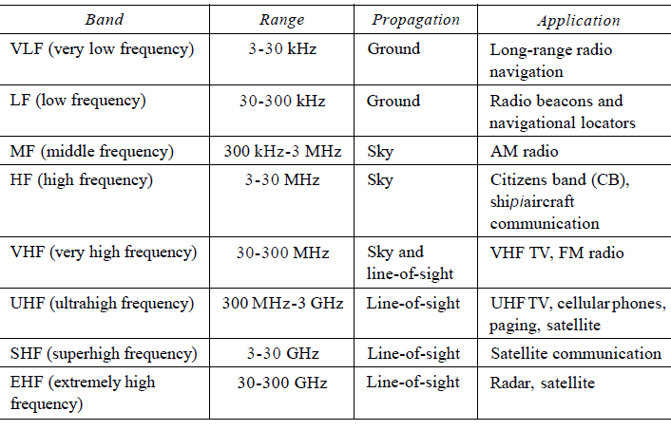
Contd.

Slide 54
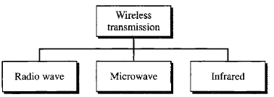
Wireless Transmission Types
We can divide wireless transmission into three broad groups: radio waves, microwaves, and infrared waves.

Slide 55
1. Radio Waves
Although there is no clear-cut demarcation between radio waves and microwaves, electromagnetic waves ranging in
frequencies between 3 kHz and 1 GHz are normally called radio waves;
waves ranging in frequencies between 1 and 300 GHz are called microwaves.
However, the behavior of the waves, rather than the frequencies, is a better criterion for classification.
Radio waves, for the most part, are Omni-directional that is, when an antenna transmits radio waves, they are propagated in all directions.

Slide 56
Contd.
This means that the sending and receiving antennas do not have to be aligned.
A sending antenna sends waves that can be received by any receiving antenna.
Radio waves, particularly those waves that propagate in the sky mode, can travel long distances.
This makes radio waves a good candidate for long-distance broadcasting such as AM radio.
Radio waves, particularly those of low and medium frequencies, can penetrate walls.

Slide 57
Contd.
This characteristic can be both an advantage and a disadvantage.
It is an advantage because, for example, an AM radio can receive signals inside a building.
It is a disadvantage because we cannot isolate a communication to just inside or outside a building.
The radio wave band is relatively narrow, just under 1 GHz, compared to the microwave band.
When this band is divided into sub bands,
the sub bands are also narrow, leading to a low data rate for digital communications.

Slide 58
Contd.
Almost the entire band is regulated by authorities (e.g., the FCC in the United States).
Using any part of the band requires permission from the authorities.
Radio waves use omnidirectional antennas that send out signals in all directions.
Based on the wavelength, strength, and the purpose of transmission, we can have several types of antennas.

Slide 59
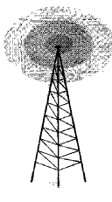
Contd.
Applications
The omnidirectional characteristics of radio waves make them useful for multicasting, in which there is one sender but many receivers.
AM and FM radio, television, maritime radio, cordless phones, etc are examples of multicasting.
Notes:
AM is a radio broadcasting using amplitude modulation transmission. It was the first method developed for making audio radio transmission and still
Used in world wide primarily for medium wave transmission but also on the long wave

Slide 60
2. Microwaves
Electromagnetic waves having frequencies between 1 and 300 GHz are called microwaves.
Microwaves are unidirectional.
When an antenna transmits microwave, they can be narrowly focused.
This means that the sending and receiving antennas need to be aligned (see each other).
The unidirectional property has an obvious advantage.
A pair of antennas can be aligned without interfering with another pair of aligned antennas.

Slide 61
Cont-----
The following describes some characteristics of microwave propagation:
Microwave propagation is line-of-sight.
Since the towers with the mounted antennas need to be in direct sight of each other, towers that are far apart need to be very tall.
The curvature of the earth as well as other blocking obstacles do not allow two short towers to communicate by using microwaves.
Repeaters are often needed for long distance communication.
Very high-frequency microwaves cannot penetrate walls.

Slide 62
Contd.
This characteristic can be a disadvantage if receivers are inside buildings.
The microwave band is relatively wide, almost 299 GHz.
Therefore wider subbands can be assigned, and a high data rate is possible
Use of certain portions of the band requires permission from authorities.

Slide 63
Unidirectional Antenna
Microwaves need unidirectional antennas that send out signals in one direction.
Two types of antennas are used for microwave communications:
parabolic dish and the horn.
A parabolic dish antenna is based on the geometry of a parabola:
Every line parallel to the line of symmetry (line of sight) reflects off the curve at angles such that all the lines intersect in a common point called the focus.

Slide 64
Cont---
The parabolic dish works as a funnel, catching a wide range of waves and directing them to a common point.
In this way, more of the signal is recovered than would be possible with a single-point receiver.
Outgoing transmissions are broadcast through a horn aimed at the dish.
The microwaves hit the dish and are deflected outward in a reversal of the receipt path.

Slide 65
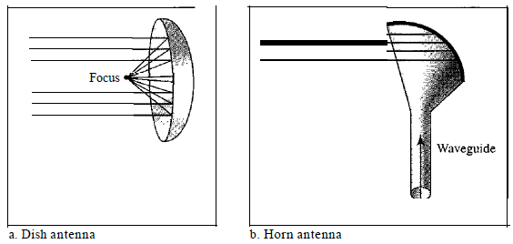
Contd.
A horn antenna looks like a gigantic scoop.
Outgoing transmissions are broadcast up a stem (resembling a handle) and deflected outward in a series of narrow parallel beams by the curved head.
Received transmissions are collected by the scooped shape of the horn, in a manner similar to the parabolic dish, and are deflected down into the stem.

Slide 66
Applications
Microwaves, due to their unidirectional properties, are very useful when unicast (one-to-one) communication is needed between the sender and the receiver.
They are used in cellular phones, satellite networks , and wireless LANs.

Slide 67
3. Infrared
Infrared waves, with frequencies from 300 GHz to 400 THz (wavelengths from 1 mm to 770 nm), can be used for short-range communication.
Infrared waves, having high frequencies, cannot penetrate walls.
This advantageous characteristic prevents interference between one system and another;
a short-range communication system in one room cannot be affected by another system in the next room.
When we use our infrared remote control, we do not interfere with the use of the remote by our neighbors!!!

Slide 68
Cont----
However, this same characteristic makes infrared signals useless for long-range communication.
In addition, we cannot use infrared waves outside a building
because the sun's rays contain infrared waves that can interfere with the communication.
The infrared band, almost 400 THz, has an excellent potential for data transmission.
Such a wide bandwidth can be used to transmit digital data with a very high data rate.

Slide 69
Applications
The Infrared Data Association (IrDA), an association for sponsoring the use of infrared waves,
has established standards for using these signals for communication between devices such as keyboards, mice, PCs, and printers.
For example, some manufacturers provide a special port called the
IrDA port that allows a wireless keyboard to communicate with a PC.

Slide 70
Applications
The standard originally defined a data rate of 75 kbps
for a distance up to 8 m.
The recent standard defines a data rate of 4 Mbps.
Infrared signals defined by IrDA transmit through line of sight;
the IrDA port on the keyboard needs to point to the PC for transmission to occur.
Infrared signals can be used for short-range communication in a closed area using line-of-sight propagation!!!

Slide 71
Bluetooth technology allows devices to communicate with each other without cables or wires. Bluetooth relies on short-range radio frequency, and any device that incorporates the technology can communicate as long as it is within the required distance
Bluetooth specification details the entire protocol stack. Bluetooth employs Radio Frequency (RF) for communication. It makes use of frequency modulation to generate radio waves in the ISM band.

Slide 72
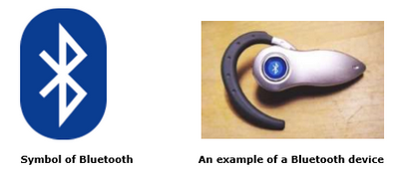

Slide 73
The usage of Bluetooth has widely increased for its special features.
Bluetooth offers a uniform structure for a wide range of devices to connect and communicate with each other.
Bluetooth technology has achieved global acceptance such that any Bluetooth enabled device, almost everywhere in the world, can be connected with Bluetooth enabled devices.
Low power consumption of Bluetooth technology and an offered range of up to ten meters has paved the way for several usage models.
Bluetooth offers interactive conference by establishing an adhoc network of laptops.
Bluetooth usage model includes cordless computer, intercom, cordless phone and mobile phones.

Slide 74
An ad-hoc network is a chain of devices that are connected to each other instead of connecting through a central access point such as a server or router. This allows devices on a local area network to share and exchange data between each other
An ad hoc network is one that is spontaneously formed when devices connect and communicate with each other. The term ad hoc is a Latin word that literally means "for this," implying improvised or impromptu.
Ad hoc networks are mostly wireless local area networks (LANs). The devices communicate with each other directly instead of relying on a base station or access points as in wireless LANs for data transfer co-ordination. Each device participates in routing activity, by determining the route using the routing algorithm and forwarding data to other devices via this route.

Slide 75
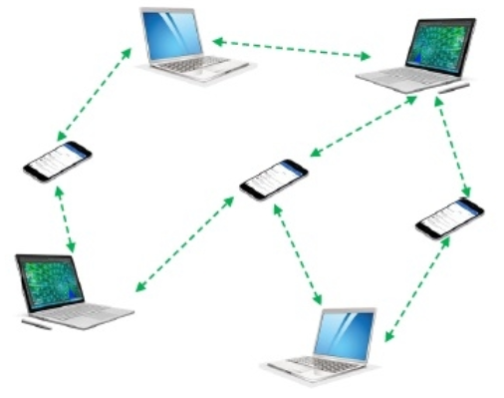

Slide 76
Classifications of Ad Hoc Networks
Ad hoc networks can be classified into several types depending upon the nature of their applications. The most prominent ad hoc networks that are commonly incorporated are illustrated in the diagram below

Slide 77
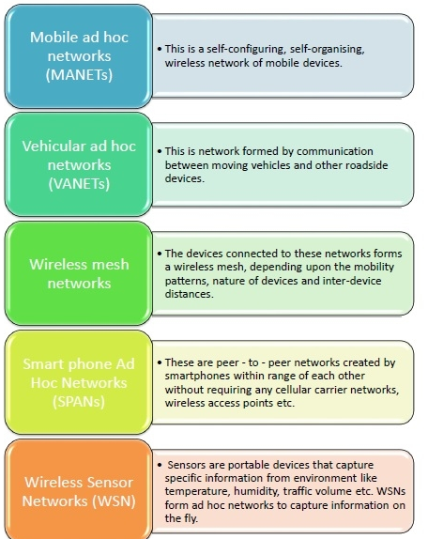

Slide 78
Applications of Ad Hoc Networks
Ad hoc networks serve various purposes, including:
Gives military units access to all soldiers, vehicles, and headquarters
Allows users to create personal area networks (PANs) or short-range local networks that connects several nodes
Provides emergency responders to send signals during crises
Useful in monitoring patients
Helps check for weather conditions, forest fires, tsunamis, and other natural or man-made disasters

Slide 79
Challenges Related to Ad Hoc Networks
Ad hoc networks may be convenient for impromptu connections where a WLAN is unavailable, but they come with a few disadvantages. Bandwidth limitation, for instance, is a top issue for ad hoc network users. Connections on ad hoc mode can only reach a speed of 11 Mbps. However, Wi-Fi connections can reach 54 Mbps in infrastructure mode.
Do Ad Hoc Networks Present Security Risks?
Because ad hoc networks are typically set up for short-term use particularly during emergencies, they can pose security risks. They are specifically prone to denial-of-service (DoS) attacks since they’re designed to be accessible to anyone. People with malicious intentions can thus overwhelm them to render them useless.
Given their short-range nature, ad hoc networks are also prone to routing information corruption. Anyone who wishes to spy on communications coursed through them can easily sniff data.

